Slide 1

Drafting Income Projections: Developing a Predictive Model to Surpass the 50K Threshold
Made by:
Priyanka Kolhe

Slide 2

Project Objective
The objective is to leverage the available features to construct a predictive model capable of discerning whether an individual's income surpasses a predefined threshold, specifically exceeding 50K.
Aim - understand the key factors that contribute to higher incomes
Uncover insights into the socioeconomic dynamics and employment characteristics that correlate with elevated income levels
Model can provide valuable information for policymakers, researchers, and individuals seeking to comprehend the determinants of financial success across diverse geographic and demographic contexts.

Slide 3
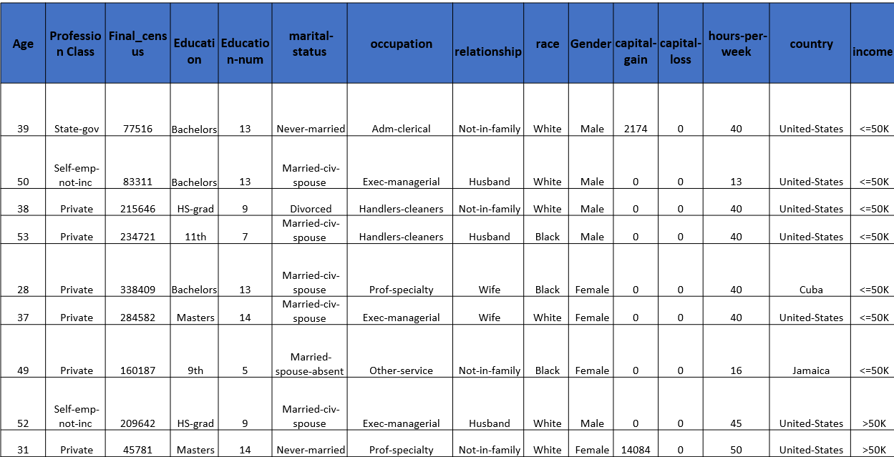
Dataset

Slide 4


Age: The age of an employee
Work-class: Profession category
Final_census : Census (population of the country)
Education: Type of last (max) Education
Education_num: Years spend on studies
Marital Status: Person married or not
Occupation: Job or profession
Relationship: Bounded by any relation or dependent
Race: Ethnicity of the employee
Gender: Gender of the employee
Capital-gain: Profit earned when selling a capital asset, such as stocks, real estate, or valuable possessions
Capital-loss: Financial loss incurred when selling a capital asset at a price lower than its original purchase price
Hours/week: How many working hours in a week
Country: Country where it belongs
Income threshold(Target Column) : Two range of Income one is <=50k and >50K
Data Dictionary

Slide 5
About Data
The data consists of 32561 rows, 15 columns.
The data has 6 numerical variables:
Age, Final_census, Education-num, capital-gain, capital-loss, hours-per-week
The data has 9 categorical variables:
Profession Class, Education, marital-status, occupation, relationship, race, Gender, country, income
It has 14 independent variables:
Age, Profession Class, Final_census, Education, Education-num, marital-status, occupation, relationship, race, Gender, capital-gain, capital-loss, hours-per-week, country, income
Dependent variable: income

Slide 6
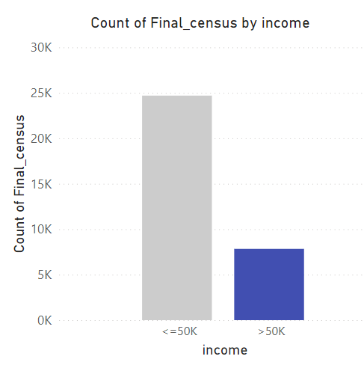
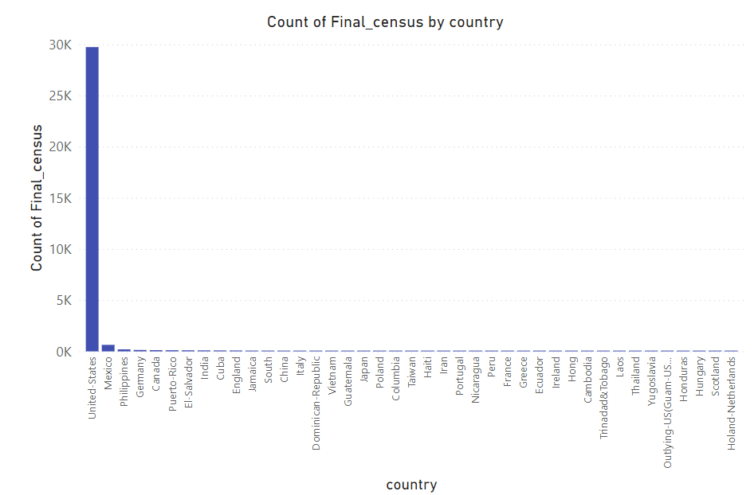
Population
Analysis
Looking at the first graph, the population with income greater than 50K is less than half of the population with income less than 50K. The United States has the largest population among all other countries.

Slide 7
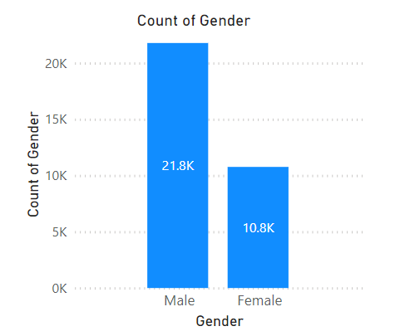
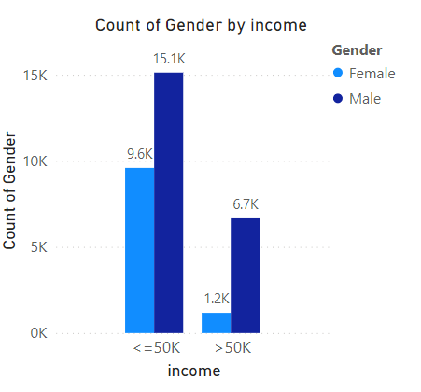
Income by Gender
Here, males are more prominent than females. Even when expecting income exceeding 50K, males are more prominent.

Slide 8
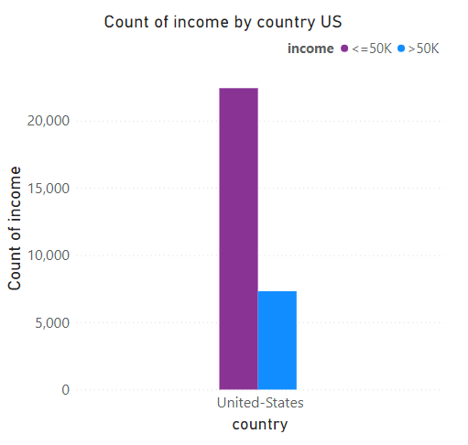
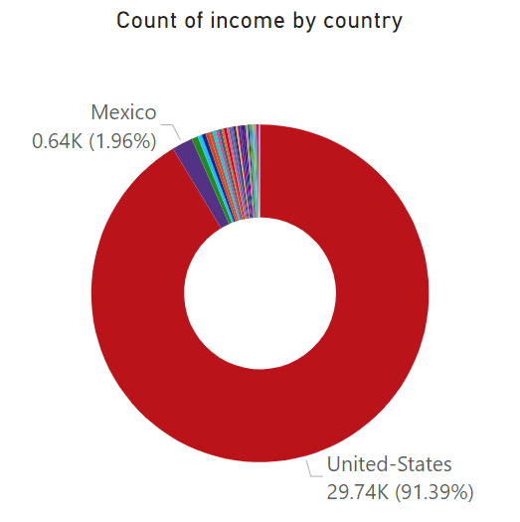
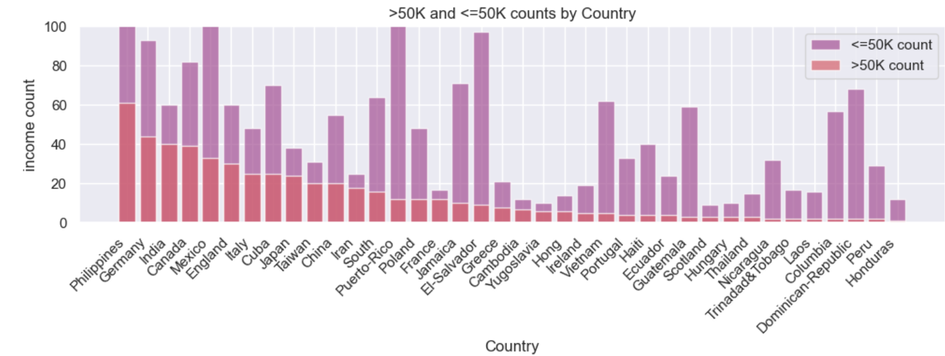
Income by Country
In the population, the United States is the major source of providing income greater than 50K.
The US has almost 5000 people with income greater than 50K, while other countries have populations in the hundreds only.

Slide 9
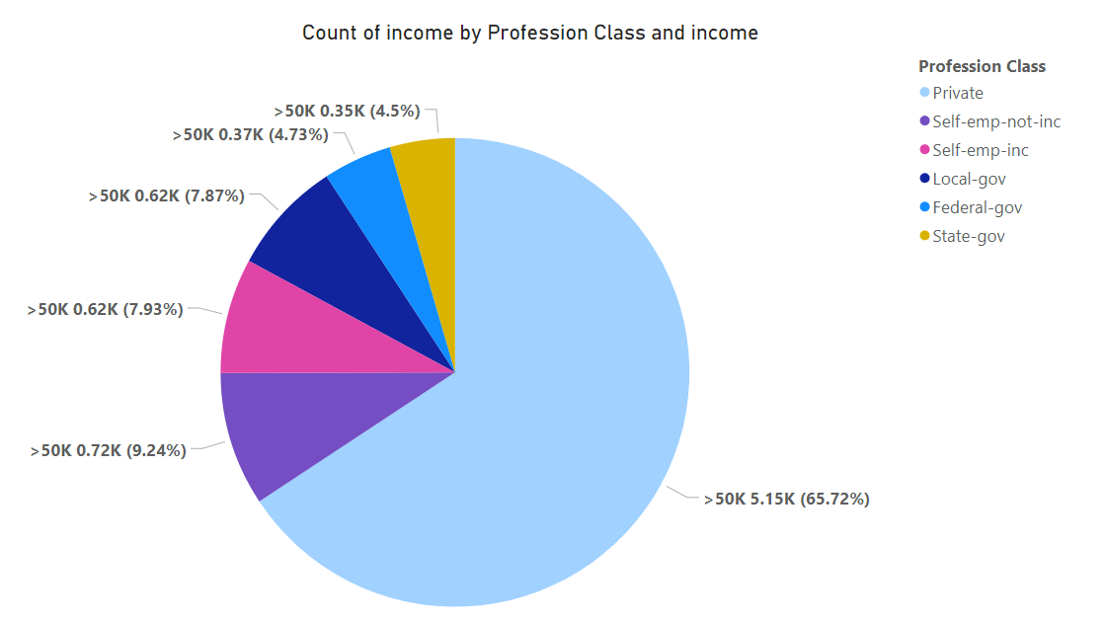
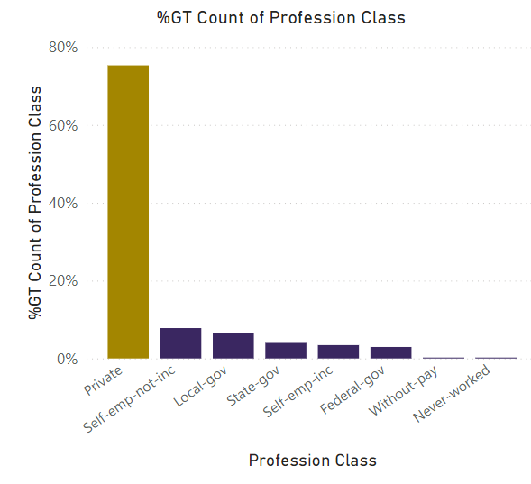
Income by Profession Class
The profession class “Private” has a larger population than all other profession classes.
Also, the profession class “Private” is a major source of providing income greater than 50K.

Slide 10
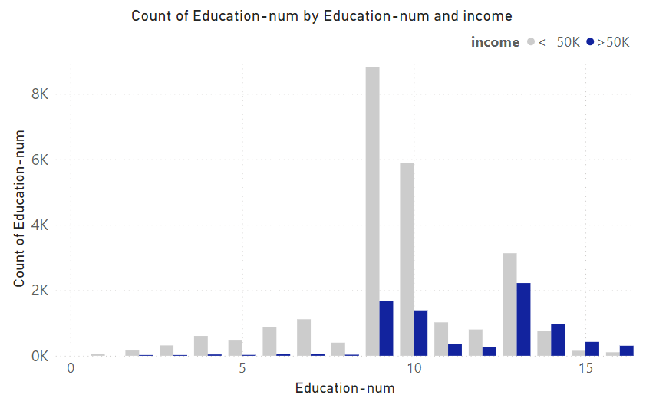
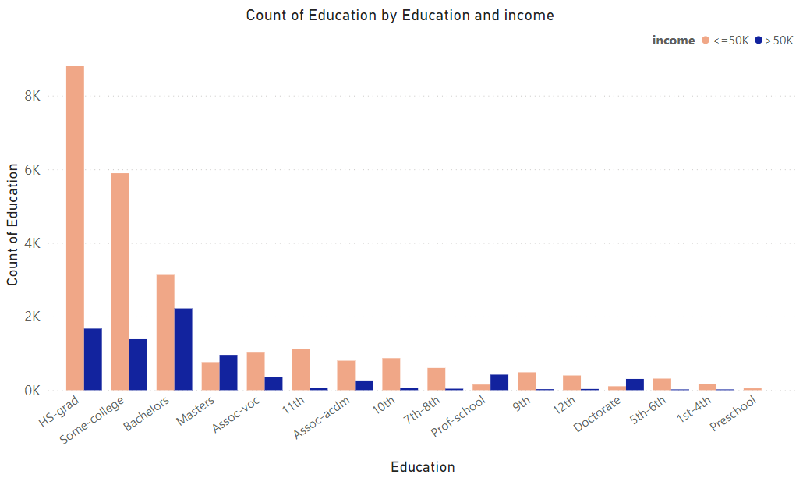
Income by Education
The population with an education number greater than 9 has the potential to have an income greater than 50K. Specifically, those with an education number of 13 have higher chances of having income exceeding 50K.
Upon examining graph 2, it is evident that individuals with education levels HS-grad, Some College, Bachelors, and Masters have greater chances of having income surpassing 50K. Among these, those with a Bachelors degree have the highest likelihood of earning more than 50K. Additionally, the population with a Masters degree can be targeted for income-related considerations.

Slide 11
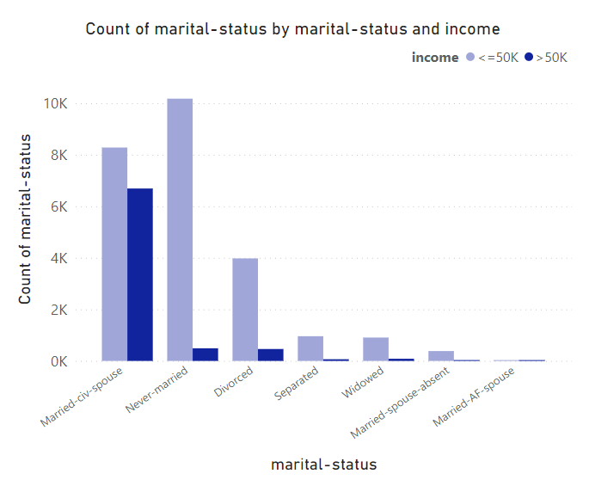
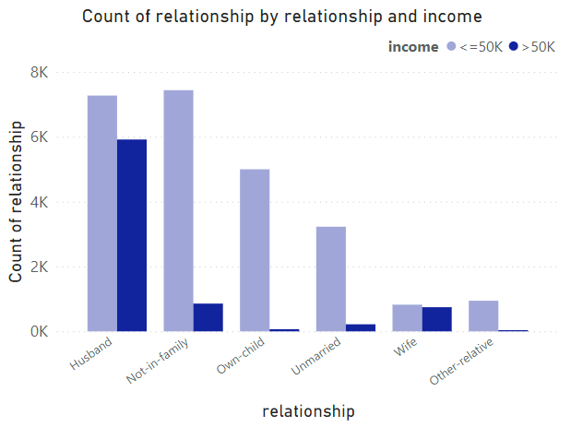
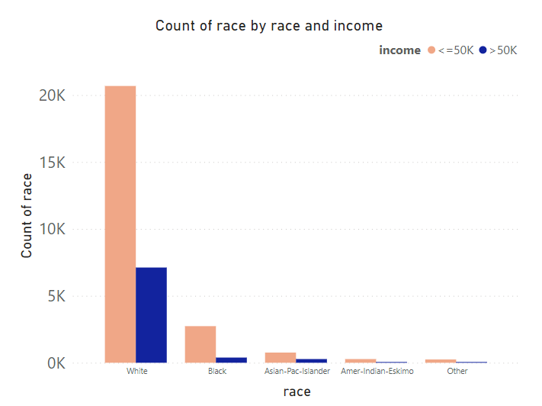
Relationship Analysis
The population with the marital status "Married-civ-spouse" and the relationship "Husband" has higher chances of having income greater than 50K.
Additionally, it can be observed that the population with the race "White" also has higher chances of having income greater than 50K.

Slide 12
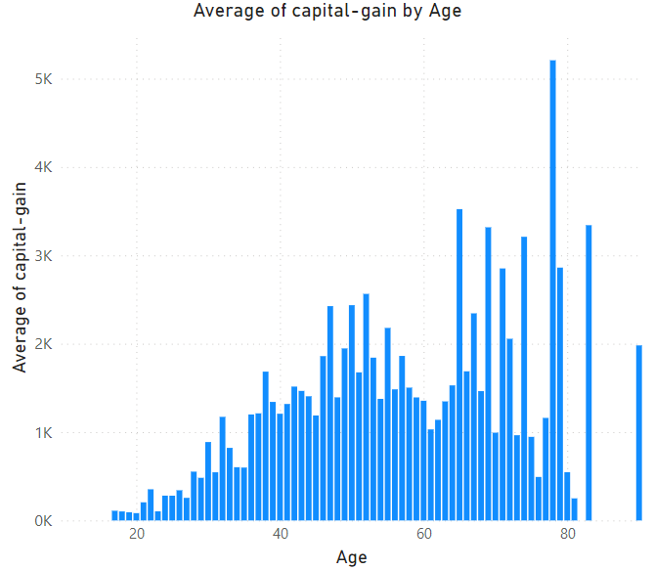
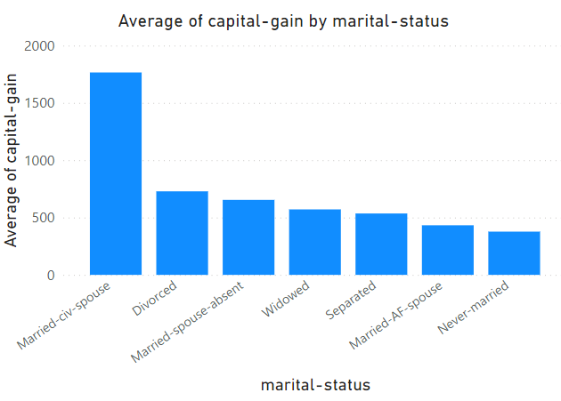
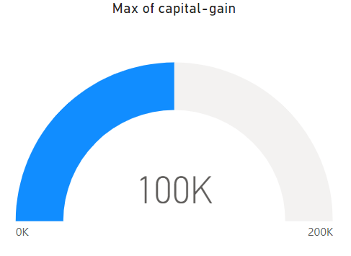
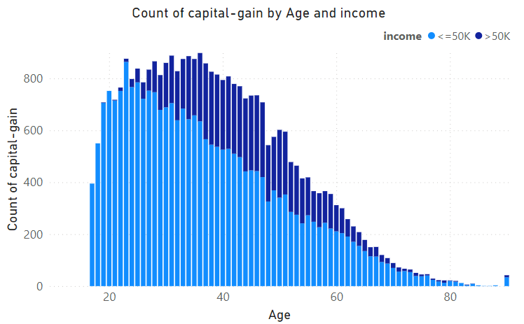
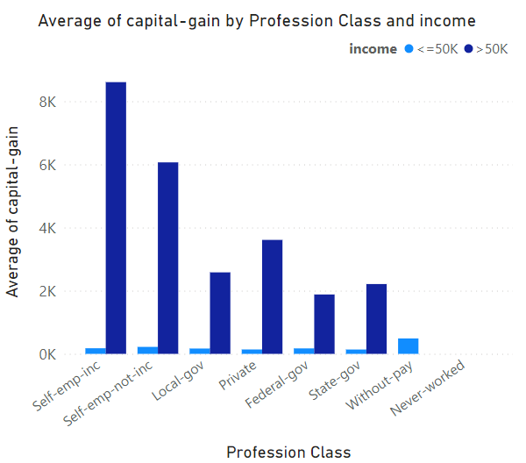
Capital Gain Analysis
Individuals with certain characteristics may achieve a good amount of capital gain. These include those in the profession class Self-emp-inc, individuals with a marital status of Married-via-spouse, and those aged above 40.
Furthermore, the population count is higher for individuals obtaining capital gain within the age range of 25 to 50.

Slide 13
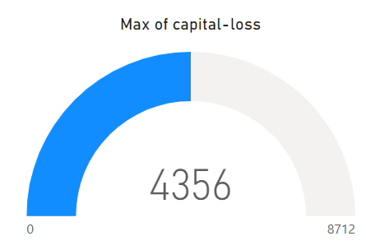
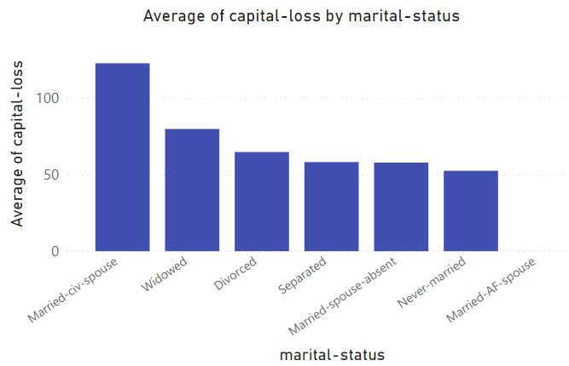
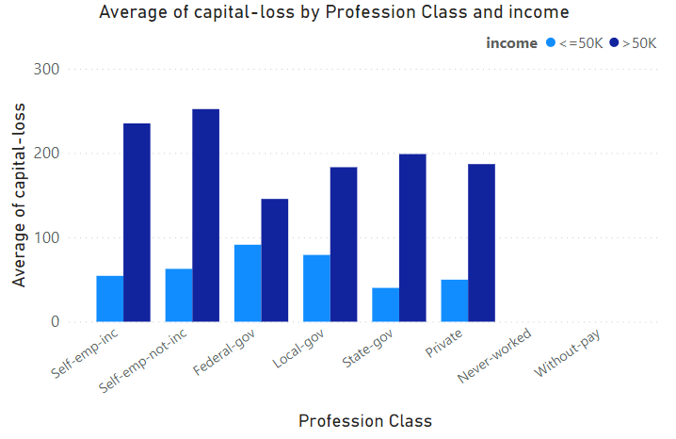
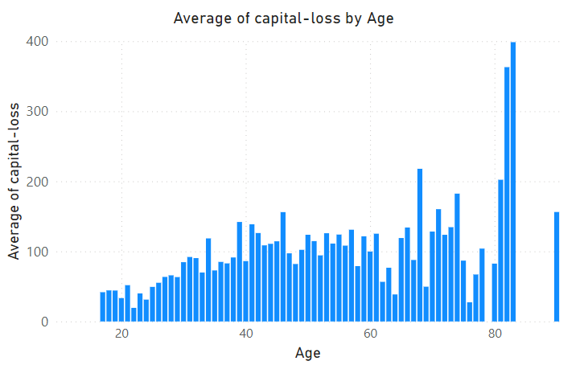
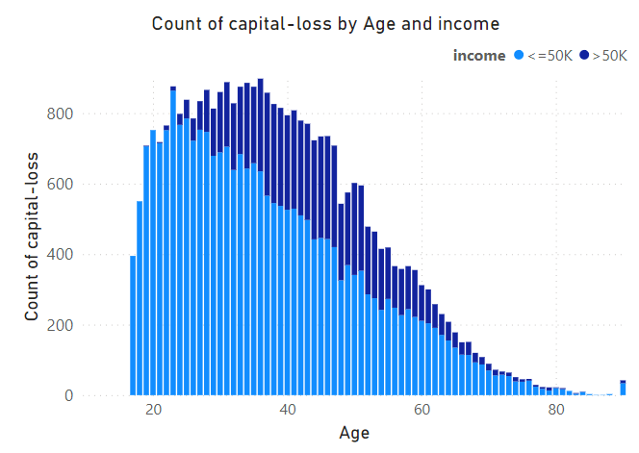
Capital Loss Analysis
Individuals from any profession class, age group, or marital status may experience capital loss.
However, focusing on the graph depicting the “average capital loss by age”, it is noticeable that the population with an age greater than 80 is more likely to incur higher capital losses.

Slide 14
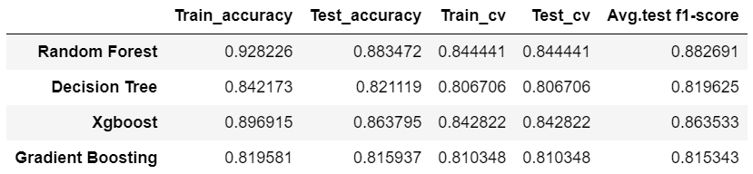
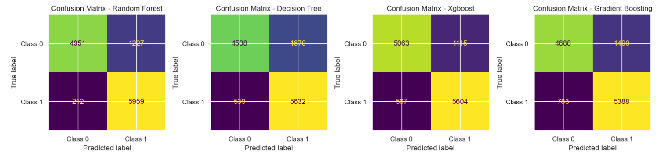
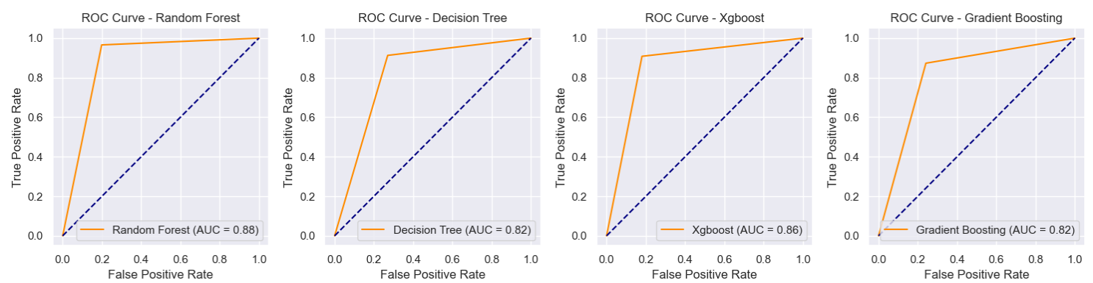
To predict whether an individual's income exceeds 50K or not based on the given data, three models were constructed: the Random Forest Model, Decision Tree Model, Xgboost Model, and Gradient Boosting Model.
ML Model Analysis

Slide 15
Upon reviewing the results, it's evident that the random forest model exhibits superior training and testing accuracy compared to other models. The training accuracy stands at approximately 92%, while the testing accuracy is around 88%.
In the confusion matrix for the random forest, both the false positive and false negative counts are lower compared to other models, with '1227' false positives and '212' false negatives.
The random forest model outperforms other models with a superior average F1 score, reaching approximately 92%.
After analyzing the results, it becomes evident that the 'Random Forest Model' is the preferred predictive model.
Conclusion
Insights to target individuals with incomes exceeding 50K:
In the population, the United States is the major source of providing income greater than 50K.
In the population, males are more prominent than females
The profession class “Private” is a major source of providing income greater than 50K.
The Population with an education number of 13 has higher chances of having income exceeding 50K.
The population with the marital status "Married-civ-spouse" and the relationship "Husband" has higher chances of having income greater than 50K.
The population with the race "White" also has higher chances of having income greater than 50K.

